Slide 1
Toxic Trespass Skill-Share:
Accessible science tools for developing EJ leadership
Riki Ott • Bridgette • Yvette • Tabitha
Murry Arellano Tripp
a project of Earth Island Institute

Slide 2
TOXIC TRESPASS
Health Concerns with Oil-Chemical Exposures

Slide 3
TOXIC TRESPASS ~ Objectives
We will learn to:
Identify oil-chemical hazards in the environment & explain how exposures occur
Explain how these exposures could affect health
Recognize symptoms related to oil-chemical exposures
Identify ways to reduce oil-chemical exposures in your environment
Find a qualified Health Care Provider to properly diagnosis & treat oil-chemical illnesses

Slide 4
Why is this important?
Cost to global GDP – 10% or over $7.5 trillion
Cost to U.S. – $340 billion from endocrine disruptors
Chemical illnesses are preventable
© 2002 Subhankar Banerjee
Silent Snow: The Slow Poisoning of the Arctic, Cone, 2005
Notes:
Global GDP: J Envir. Health, 2017 health care, loss of productivity YLD, lost wages
Cost to US: The Lancet Diabetes & Endrocrinology, 2016
Don’t go “away” Settle in Arctic
Silent Snow: The Slow Poisoning of the Arctic, 2005, heavy metals, POPs, DDT, sickening and endocrine disruption of apex predators – human, polar bears, seals

Slide 5
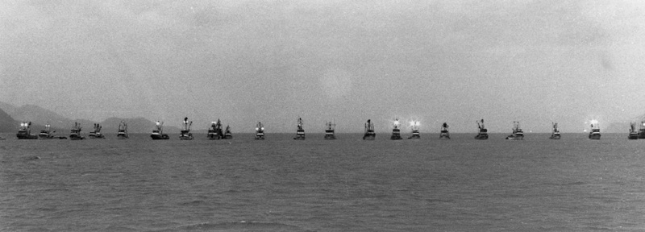
Why “oil-chemical” pollutants?
“Pollutant” and “Hazardous substances” in Superfund
“Oil” in
Clean Water Act
Oil particulates (PAHs) cause harm at very low levels
Fishermen’s blockade, Prince William Sound, Alaska, 1993
Tony Bickert
Pollutant: may cause • death • disease or infection
• behavioral abnormalities • cancer • genetic mutation
• endocrine disruption • reproductive malfunction and
• other physical malfunction • in exposed organisms & their offspring including humans.
10 Americans, 2012
https://www.ewg.org/kid-safe-chemicals-act-blog/kid-safe-chemicals-act-10-americans-video/
Notes:
“Industrial pollution begins in the womb.” ~ Ken Cook, EWG

Slide 6
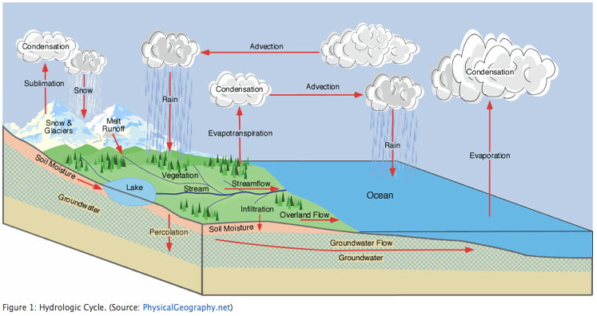
Water cycle & oil-chemical hitchhikers
Aquifer
Living Downstream, Steingraber, 1998
Toxic Chemical Soup with Dr. Arlene Blum
https://www.youtube.com/watch?v=2pWjnW0Xwpg

Slide 7
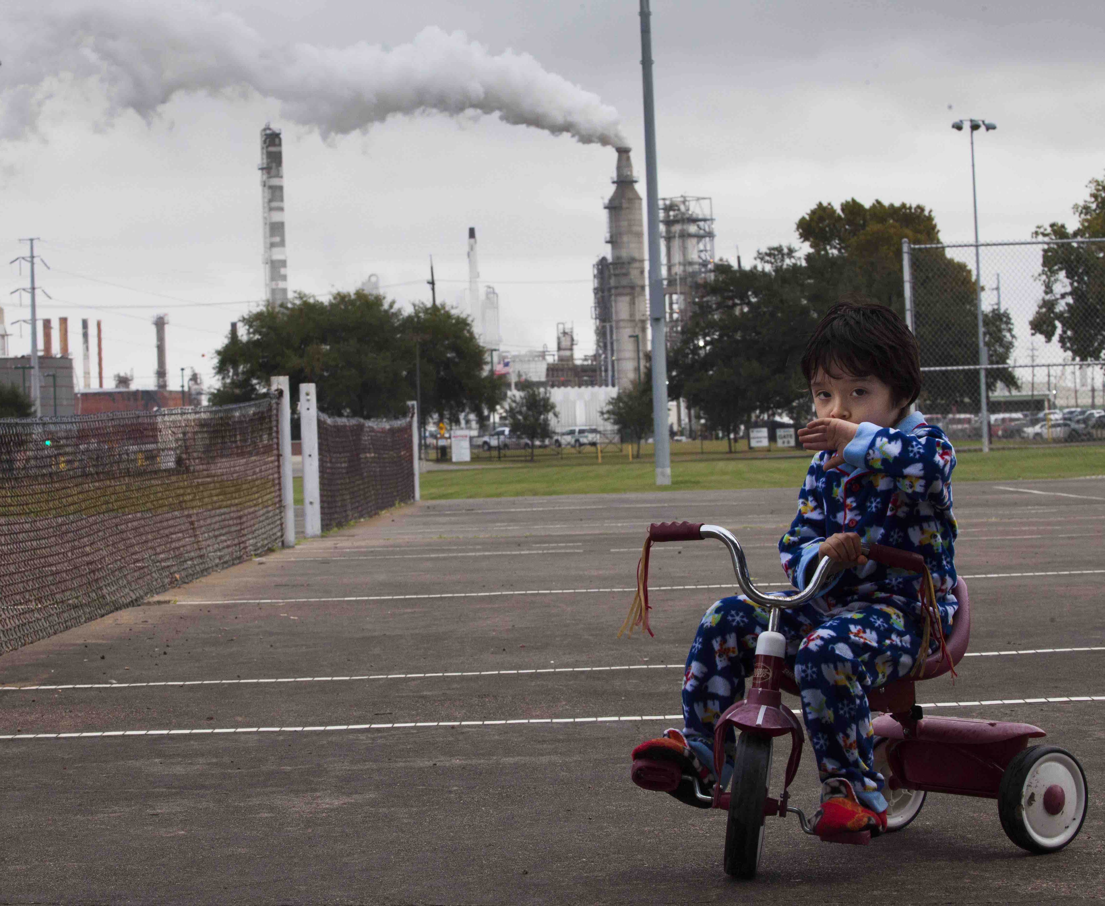
Routes of oil-chemical exposures
INTO BODY
Inhaling
Skin contact
Eating
Drinking
OUT OF BODY
Exhaling
Sweating
Pee, poop, throw up
Menstruating, birthing, nursing
INSIDE BODY
Metabolized
– organs
– enzymes*
(*babies & kids)
Eliminated
Stored
Courtesy of TEJAS
Manchester (Houston)

Slide 8
Oil-chemical exposures & health effects
Acute common symptoms
Cold/ flu-like symptoms
Worse asthma/ bronchitis
Affected systems
Bad headaches
Brain fog, memory loss, forgetfulness
Dizziness, nausea
Tingling feet & hands
Blurry vision
Seizures
Respiratory system
Central Nervous System
Blood
Skin
Immune system
Ear & nose bleeds
Bleeding hemorrhoids
Skin rashes & lesions
Sick or tired all of the time
Graphic: Riki Ott

Slide 9
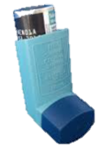
Types of susceptible people
Graphic: Riki Ott

Slide 10
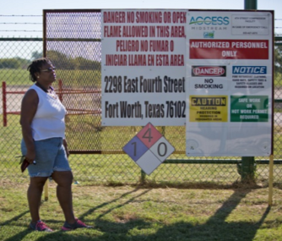
Environmental Justice stressors & health risk
Income
Proximity to industry, traffic, hazardous sites
Access to health care, nutritional food
Quality of education
Meaningful political voice
© Julie Dermansky
Sacrifice zone
People of color
People of lower socio-economic status
Where you live matters!
© Julie Dermansky

Slide 11
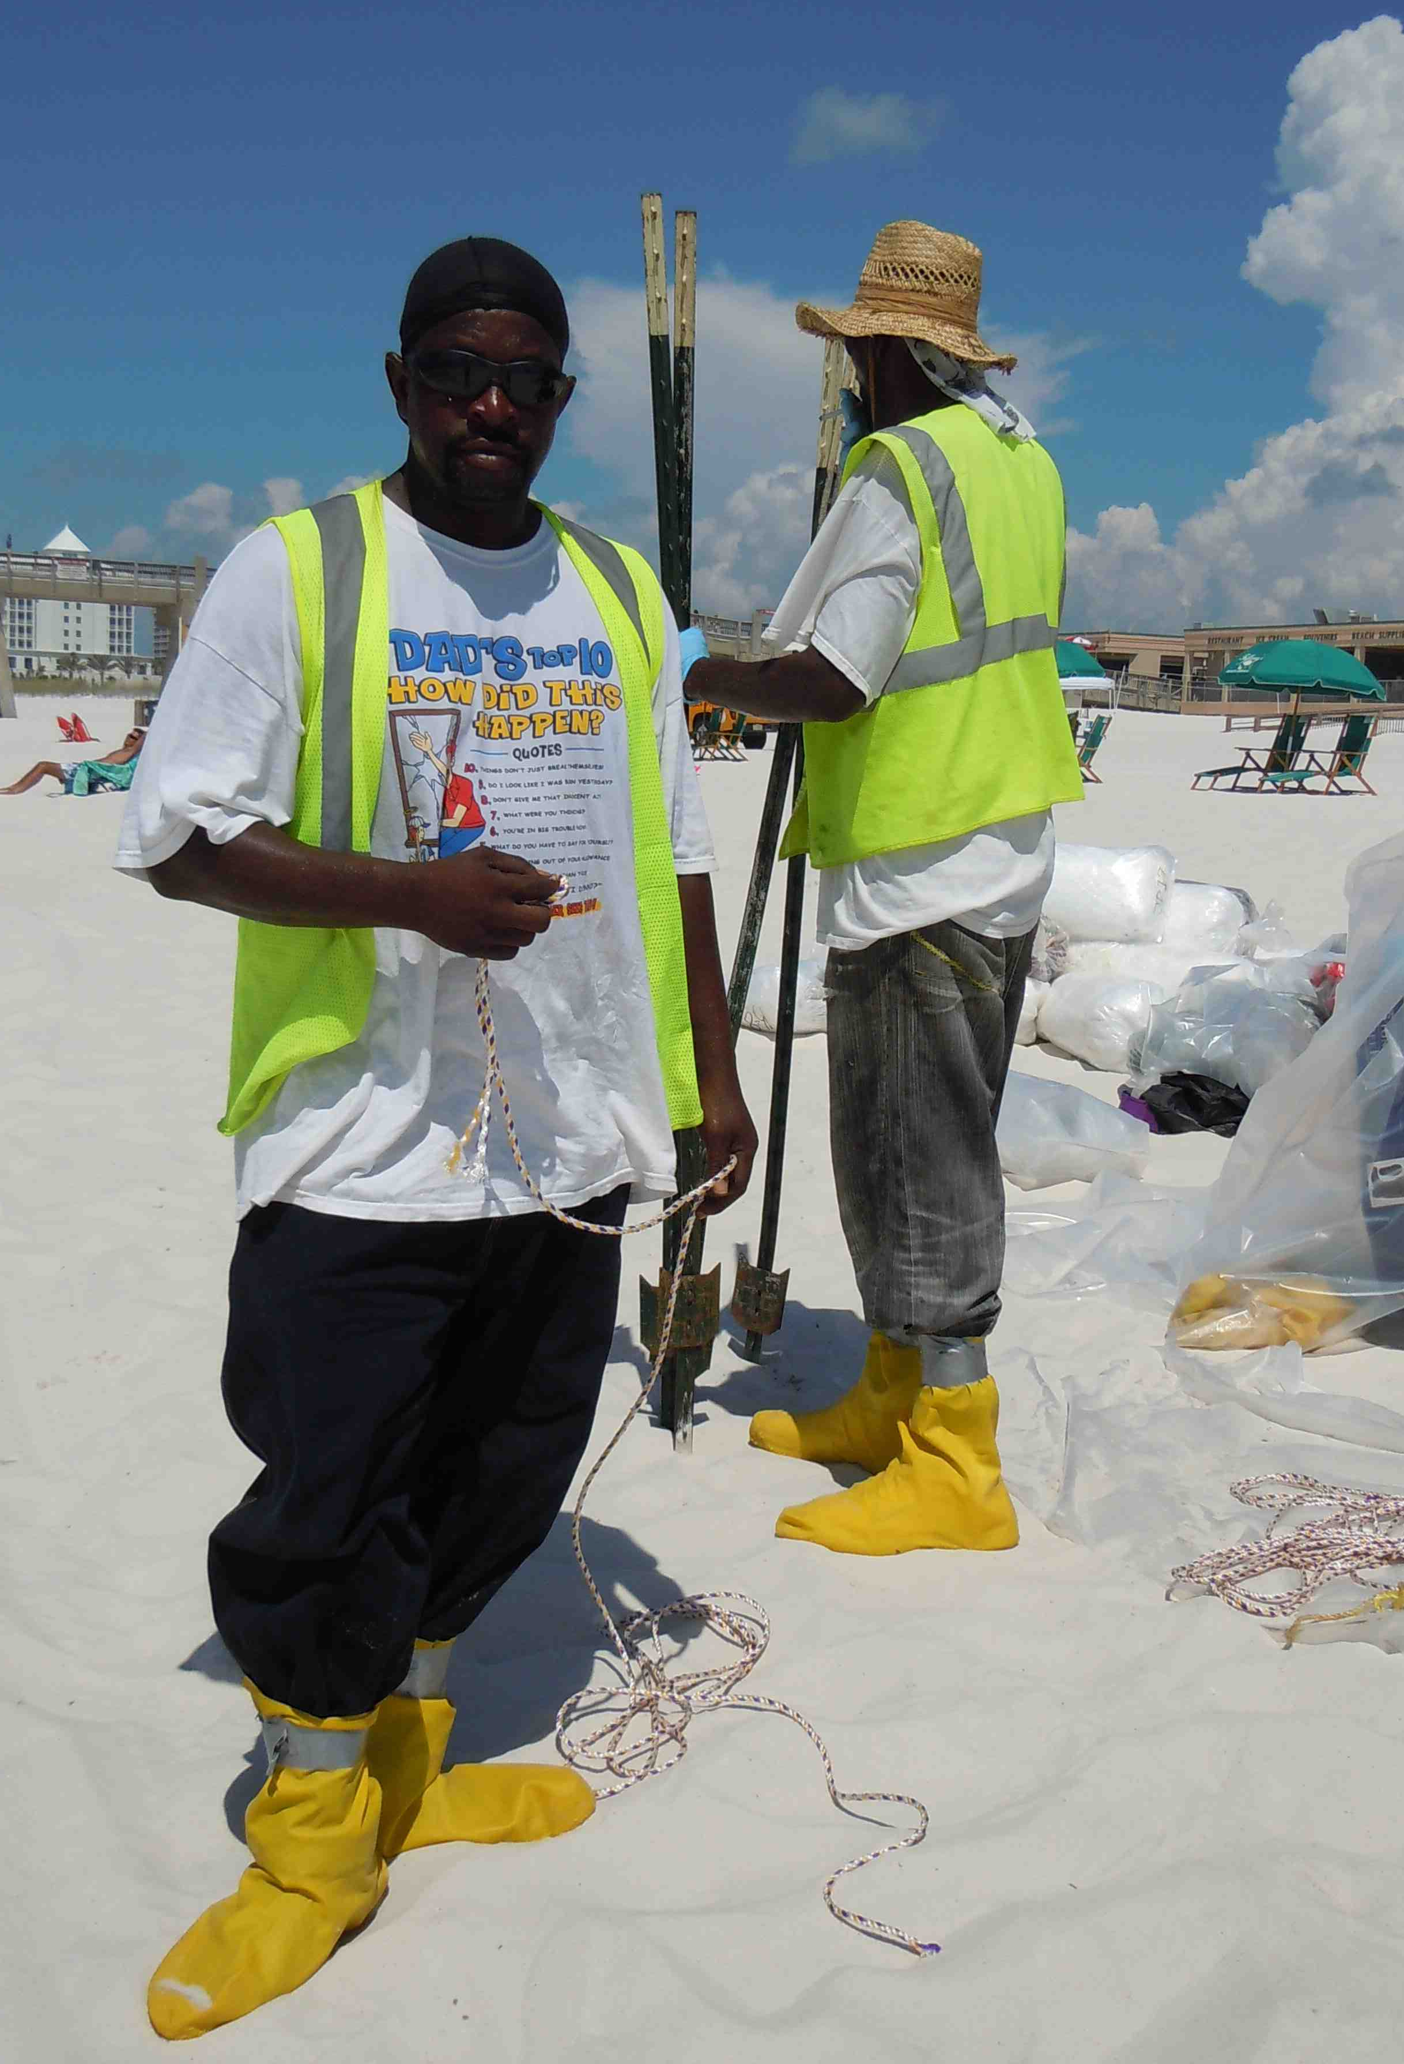
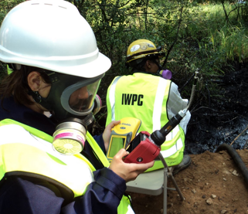
Temporary jobs = more at-risk
Enbridge spill, Michigan
EPA
No pre-hire screening
Inadequate training
No respirators
Standards outdated
Take-home exposures
Riki Ott
BP Deepwater Horizon
Notes:
same thing with evacuation zones and smoke from fires

Slide 12
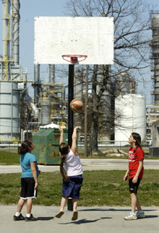
Chronic & multiple exposures
Endocrine disruptors
Interfere with body’s hormone system
Jam reproductive function
Cause birth defects & developmental disorders
Cause other problems like – neurological issues – immune system problems – cancerous tumors
Aamjiwnaang Band, CANADA
The Beloved Community www.newsreel.com
Notes:
L:
R: http://newsreel.org/guides/belovedcommunity/bcdiscuss.htm

Slide 13
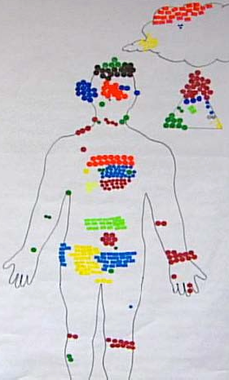
Chronic & multiple exposures
Health survey & body mapping project
Blood
Brain
Cardiovascular
Gastro-intestinal
Kidney
Liver
Nervous
Reproductive
Respiratory
Skin
Systemic
Aamjiwnaang Band, CANADA
The Beloved Community www.newsreel.com
Notes:
L:
R: http://newsreel.org/guides/belovedcommunity/bcdiscuss.htm

Slide 14
Chronic exposures
Rain barrel fills up faster than it empties
Babies exposed throughout development
Multiple exposures
Synergistic effects – pollutants target same body functions
“Safety” standards based on single pollutants
Aamjiwnaang Band, CANADA
The Beloved Community www.newsreel.com
Notes:
L:
R: http://newsreel.org/guides/belovedcommunity/bcdiscuss.htm

Slide 15
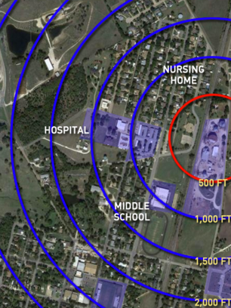
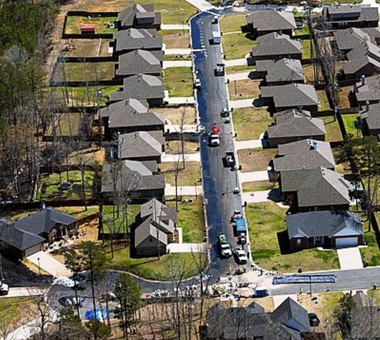
Unsafe practices
Only evacuate people if property is physically oiled
Need: recognize AIR is harmful
Agencies only take standards-based action
Need: evidence-based action
Routing of Oil-Chemicals through urban & rural areas
Need: right-to-know risks
U.S. EPA

Slide 16
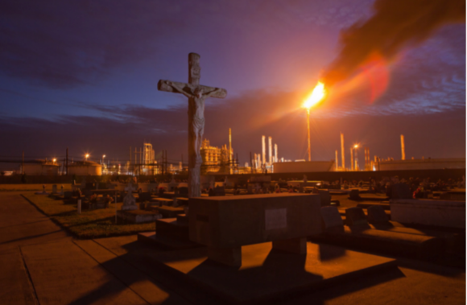
Reducing community oil-chemical exposures
“cancer alley”
2011 © Julie Dermansky
© Julie Dermansky
Photo: TEJAS
© Julie Dermansky photos

Slide 17
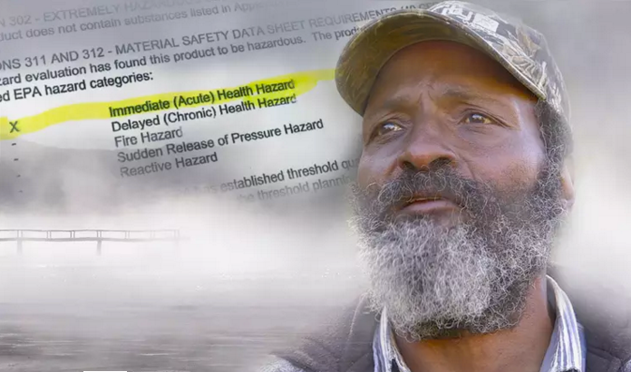
Reducing oil-chemical body burdens
Your body
Your home
Your community
Get qualified medical treatment
www.therisingfilm.tv
Notes:
Like the tide ebb & flood into our blood
Right back where started from, only symptoms may be worse b/c of chemical sensitivities

Slide 18
Understanding immune system response
Antigen (foreign substance)
A
Reaction!
B
C
Allergen
(natural)
Non-allergen
Non-allergen
(natural)
(man-made)
Cough
Cold/flu
Eye & nose irritation
Sore throat
Headache
Dizziness
Skin rash
Food
Pollen
Plants
Feathers
Pet dander
Smoke
Bee & snake venom
Bacteria
Parasites
Viruses
Mold spores (fungi)
Oil-Chemical pollutants
Transplanted tissue cells
Blood transfusions
Pharmaceutical drugs

Slide 19
Talking with your health care provider
Prepare for your visit
Ask: Is your HCP qualified to treat chemical illnesses?
Gather family’s health & exposure history & symptoms
Get informed about tests & treatments
Shutterstock
Talk with your neighbors – do others have similar health issues? Who is their HCP? What tests & treatments?
Believe in yourself – Get an Occupational & Environmental Medicine (OEM) specialist if your HCP does not understand what is causing your symptoms
QEESI: Quick Environmental Exposure Sensitivity Inventory http://drclaudiamiller.com/qeesitest/
Notes:
Include physical symptoms & mental health • Risk communication

Slide 20
New Albany shale play in southern IL
General Information
Is your HCP qualified to treat oil-chemical illnesses?
Bring your family’s health history & exposure history
What does our doctor need to know? Why?
Sources of pollutants
Likely environmental contamination of past O&G activities
Routes of exposure
Inhalation, drinking water, skin contact, eating farm food
Supporting evidence
Pets sickened & died; neighbors have similar symptoms
Map water flow, wind roses, soil types, buildings on land
Course of action
Immediate referral to OEM specialists for kids & adults
http://energyblog.nationalgeographic.com/2013/10/04/fracking-water-its-just-so-hard-to-clean/
TEJAS

Slide 21
Hurricane Harvey’s toxic legacy in TX
General Information
Is your HCP qualified to treat oil-chemical illnesses?
Bring your family’s health history & exposure history
→ What does my son’s doctor need to know? Why?
Sources of pollutants
Likely environmental contamination from O&G activities
Contaminated floodwaters; indoor air pollution; mold
Routes of exposure
Inhalation, skin contact, drinking water, locally grown food
Supporting evidence
Other sick responders, community residents & pets
Disclosure of chemicals & products released at plant
Oct. 2017, Arkema chemical plant, Crosby, TX
Course of action
Referral to OEM specialist & OB-GYN specialist
https://www.nytimes.com/2017/08/31/us/texas-chemical-plant-explosion-arkema.html

Slide 22
Toxic Trespass – What’s next?
Yvette arellano.inbox@gmail.com
Risk Management Plan for chemical disasters
Disaster Recovery Fund for people not lost profit
Tabitha
saveilwater@gmail.com
Mapping Class II injection wells in Illinois & illnesses
Toxic trespass education
Ban fracking in Illinois
Bridgette
bmurray4@sbcglobal.net
HBCU consortium project
Citizen science projects
School-community garden
Equity in disaster recovery
Riki
riki@alertproject.org
NCP dispersant rules
OCS O&G lease program v. Public Trust Doctrine
Toxic trespass litigation
Notes:
the cost of exposures to harmful oil-chemicals and heavy metals likely exceeds 10% of the global GDP (2017 study pub in JEH) $7.5 trillion in cost

Slide 23
Summary of Q&A discussion
PA: Working on mandatory health assessment baselines before fracking with Rapid Impact Assessment Tool; also QEESI (see resources)
Treating chemical sensitivity? Specialty Occupa-tional & Environmental Health doctors; “bother the doctors” to recognize & treat (share/ see resources)
Find pipeline locations? PHMSA limited use; Pipeline Safety Trust in Bellingham (pstrust.org)
Recommend: Medical Medium by Anthony William
National Tribal Emergency Management Council to scale up EJ trainings, info & disaster preparation; contact Nikos Pastos, nikospastos@hotmail.com

Slide 24
Resources
ALERT Project, Toxic Trespass Training Manual & Learning Guide, 2016 www.alertproject.org/programs/
Attina et al., Exposure to endocrine-disrupting chemicals in the U.S., The Lancet Diabetes & Endrocrinology, 2016 DOI: https://doi.org/10.106/S2213-8587(16)30275-3
Blum, Toxic Chemical Soup, Part 1 video, Green Science Policy, 2008https://www.youtube.com/watch?v=2pWjnW0Xwpg
Calvert & Foster, producers, The Beloved Community, 2006 http://newsreel.org/video/THE-BELOVED-COMMUNITY
Cone, Silent Snow: The Slow Poisoning of the Arctic, 2005
Environmental Defense Canada, Toxic Trespass: Environmental Links to Children’s Health (film, 5 min), 2008 https://www.youtube.com/watch?v=OpdqKAC73CM
Environmental Working Group, 10 Americans (film, 22 min), 2012 https://www.ewg.org/kid-safe-chemicals-act-blog/kid-safe-chemicals-act-10-americans-video/
Grandjean & Bellanger, Calculation of disease burden associated with chemical exposures, J Envir. Health, 2017 http://www.ehn.org/toxics-cost-10-percent-of-world-gdp-2514804991.html
Manning, producer, The Vanishing: Exposing the Human Costs of Oil, 2018 TBA www.therisingfilm.tv/
Miller, QEESI: Quick Environmental Exposure Sensitivity Inventory, 2016 http://drclaudiamiller.com/qeesitest/
Steingraber, Living Downstream, 1998; Having Faith, 2003; Raising Elijah, 2013

Slide 25
TOXIC TRESPASS
Contact info
Yvette Arellano arellano.inbox@gmail.com
Bridgette Murray bmurray4@sbcglobal.net
Tabitha Tripp saveilwater@gmail.com
Riki Ott riki@alertproject.org
ALERT material www.alertproject.org/programs/
a project of Earth Island Institute

